Slide 1
Website Project Presentation
Group members:
Shahbaz Khalid (9104)
AbdulRehman Khalid (7299)
Junaid Hashmi (8864)

Slide 2
Create My Site
Create my site is a website in which we solve your problems regarding to website. For example if you want to develop website we can develop your website within time and deliver your website error free. We provide support for 24/7 whenever you want to discuss we are here to hear you and discuss your problem and solve your problem in an ease manner.

Slide 3
Languages use for making website
Following are the languages used to make this website:
For Front-end
HTML
CSS
BOOTSTRAP
JAVASCRIPT
Jquery
For Back-end
PHP
MYSQL

Slide 4
Functional requirements
The functional requirements of our website are:
User interaction
Easy communication (via e-mail, WhatsApp, Facebook etc)
Capable of solving users problem
Services
Client feedback

Slide 5
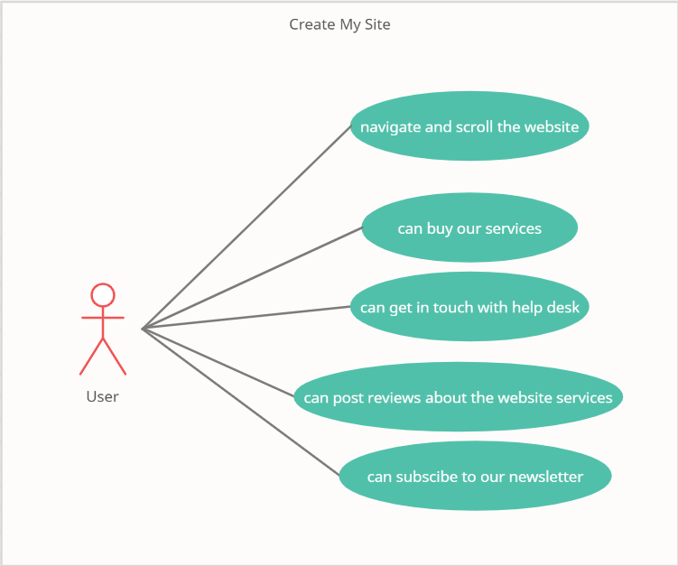
Use case diagram

Slide 6
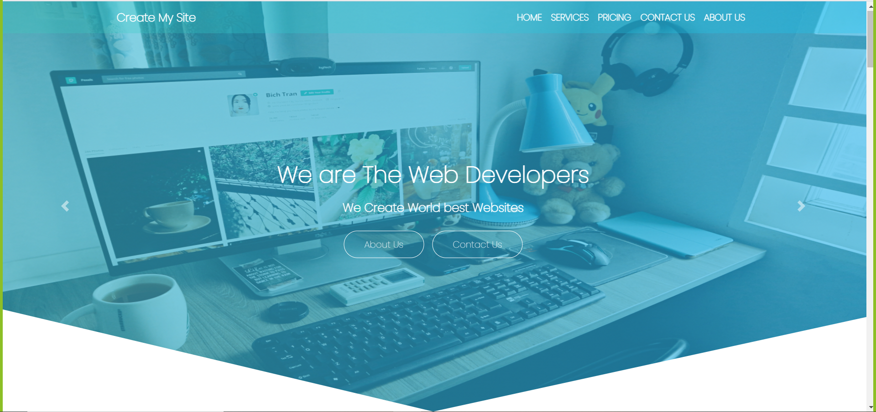
Glance of Create my site

Slide 7
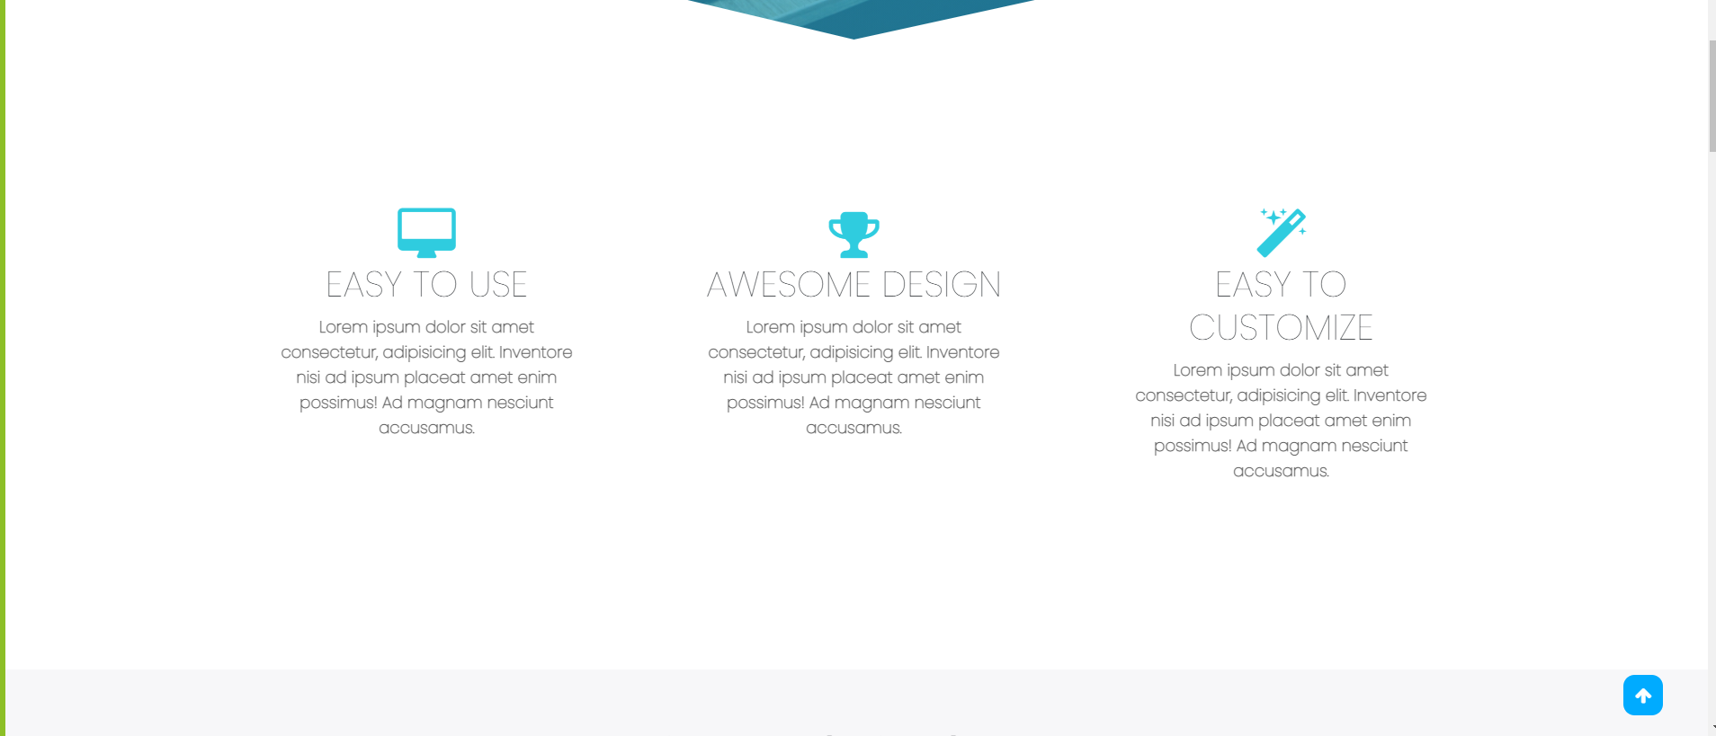
Cont…

Slide 8
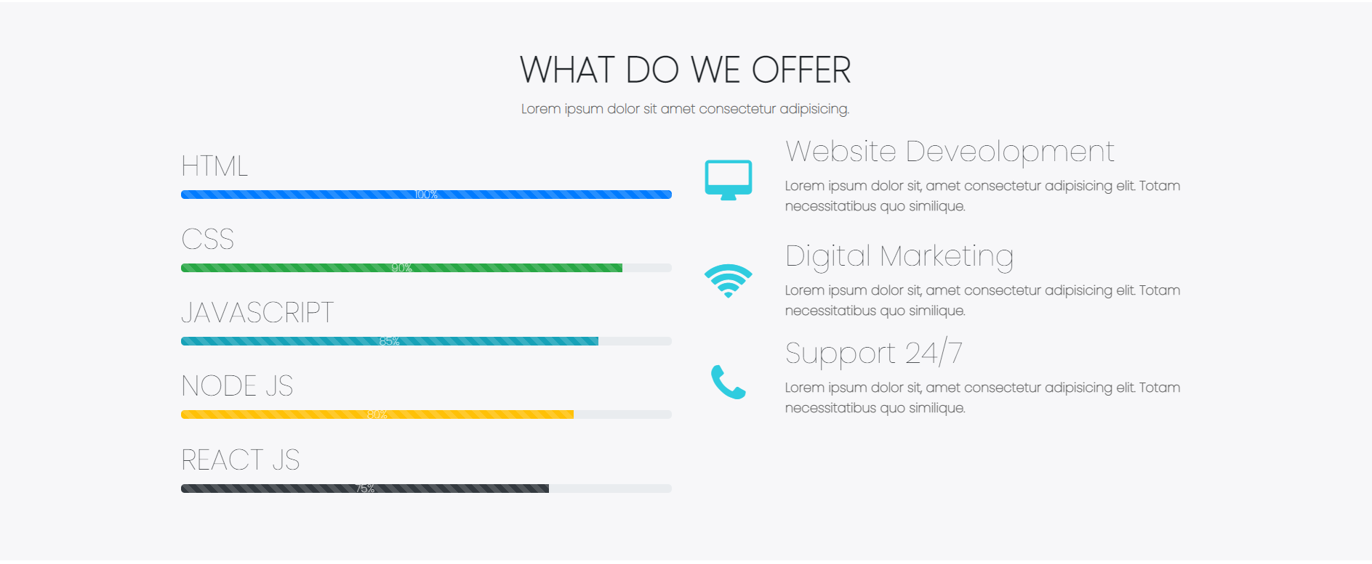
Services

Slide 9
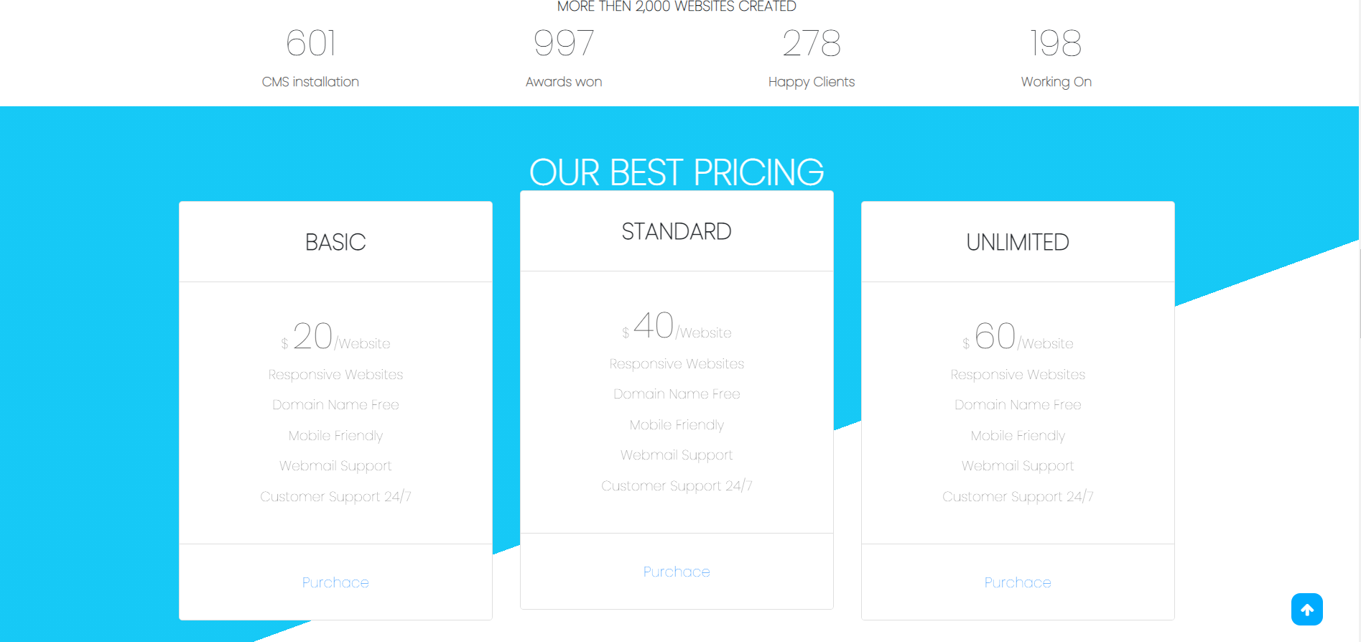
Pricing

Slide 10
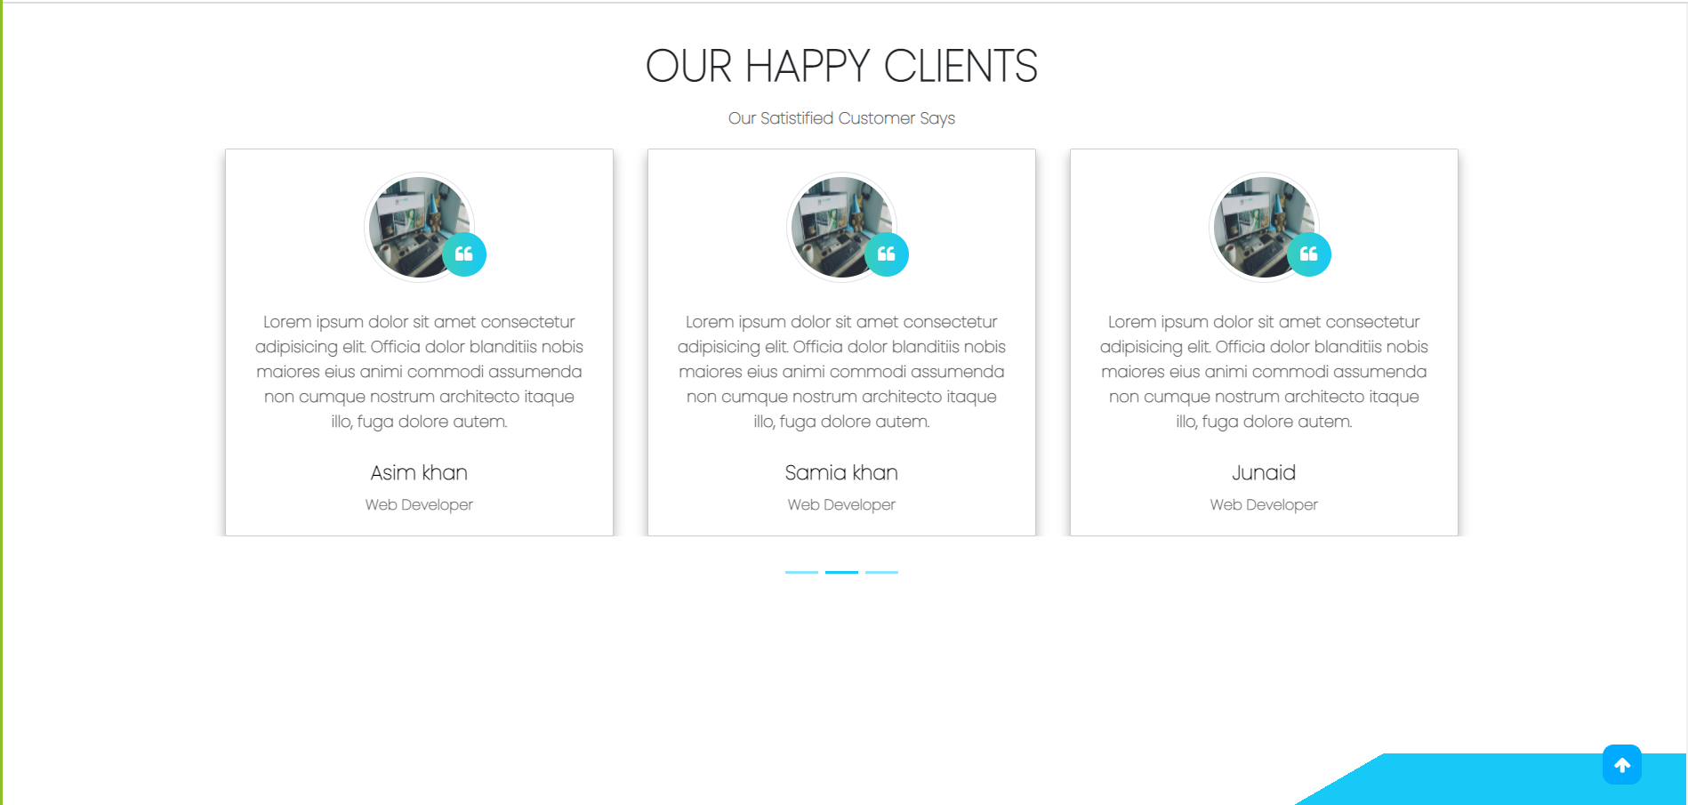
Clients Feedback

Slide 11
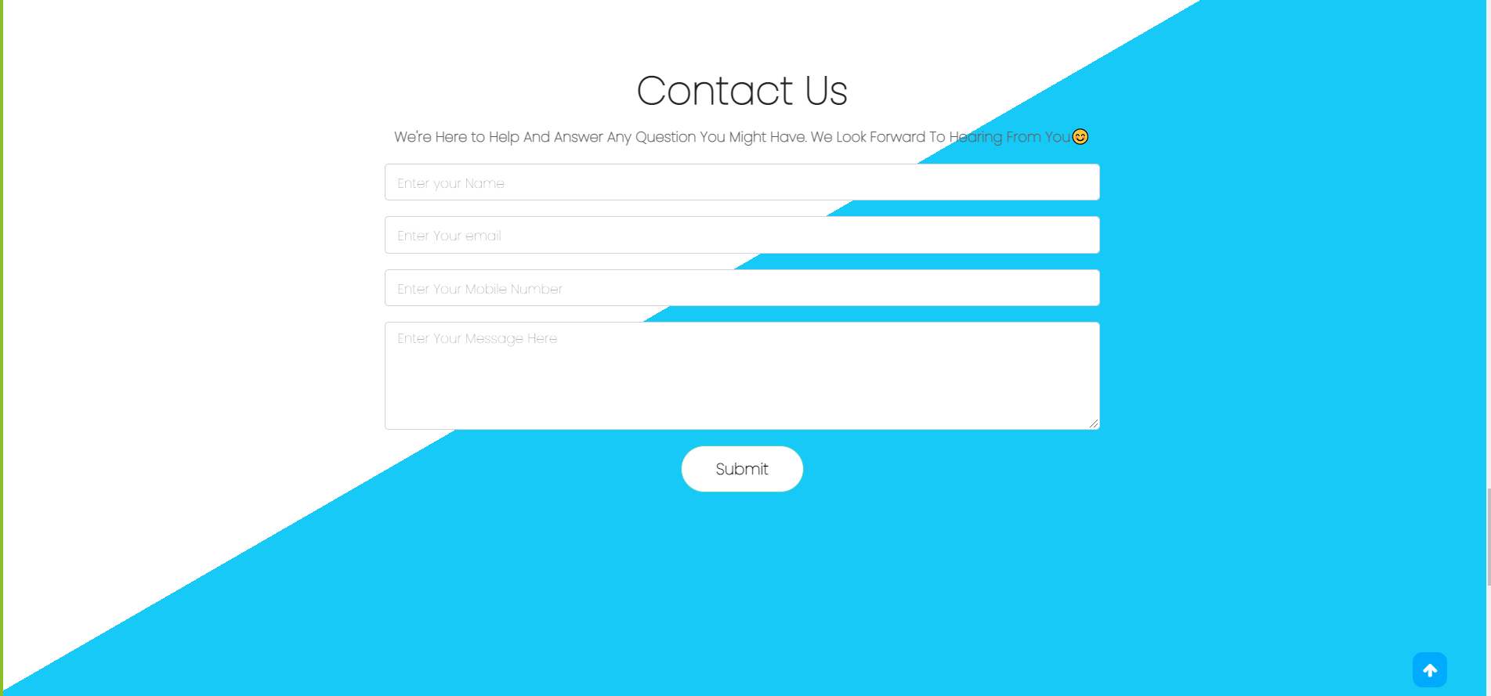
Contact Us

Slide 12
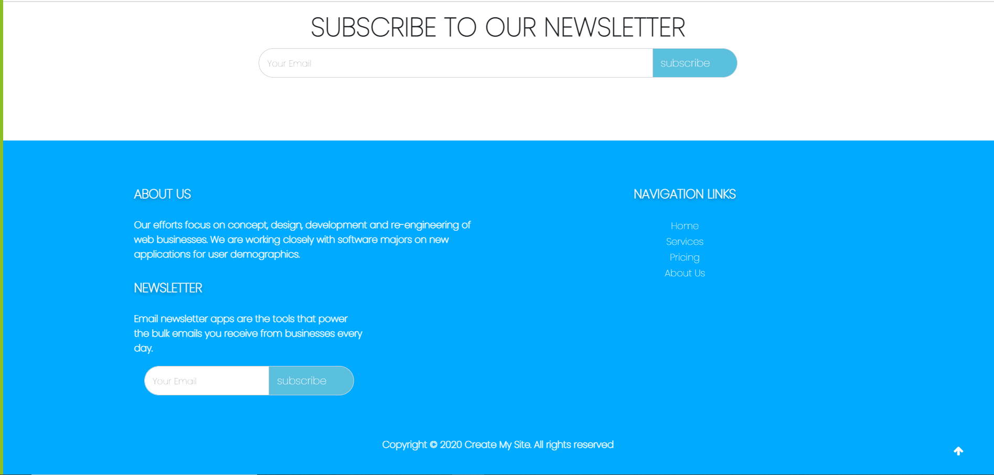
About Us

Slide 13
THANK YOU

